Slide 1
Presents
OO Programming with Java
Java Language Fundamentals
Types
Notes:
Object-Oriented Programming with Java
Java Language Fundamentals - Types
Module 2

Slide 2
Learning Objectives
Become familiar with the Java language syntax
Understand the nature and range of primitive types
Notes:
In this chapter we set aside object-oriented concepts to examine the mechanics of writing Java statements.

Slide 3
Creating Java Statements
We will begin by defining an entry point into our Java program.
We will also learn to write the statements that will fill our program and add functionality to it.
Java statements end with a semi-colon ( ; ).

Slide 4
The Structure of Java files
Beginning Java programmers are often confused about how to get their program to run. Most Java files will never run by themselves.
To create a “stand-alone” Java program you need to include a special method – the “main” method.
The instructions in the main method will run when you execute the program by itself.
If you run a program that does not have a main method, an error occurs.

Slide 5
A Simple Program with main()
  public class HelloWorld {
  public static void main(String[] args) {
  System.out.println("Hello World");
  }
  }
This is a complete Java program that will print “Hello World” when run at the command line.
When trying out the code you see in this chapter, you’ll probably want to embed it in a main method.
Notes:
HelloWorld is the class name. [We will discuss the concept of defining classes later in the course.]
main is a method – the only method – in this class.
Normally methods need to be associated with an instance of a class. Main escapes this requirement by being declared “static.” This concept is a little advanced but we will address it and the other modifiers in front of the main method in more detail in a later chapter.

Slide 6
Java Naming Conventions
Names are used to denote classes, objects, attributes and methods.
A name is a sequence of letters and numbers and _.
Names may not start with a number.
Java names are case sensitive.
Class names utilize Camel Case (First letter in each word is capitalized).
Finals (Constants) are completely capitalized as a stylistic convention.
  Class Name: ThisIsAClassNameInCamelCase
  Constant: THIS_IS_A_CONSTANT
Notes:
Which of the following are legal and distinct identifiers in Java?
item
Item
ITEM
first-Item
first_item
first/item
firstItem
item_21
£2_item
32item

Slide 7
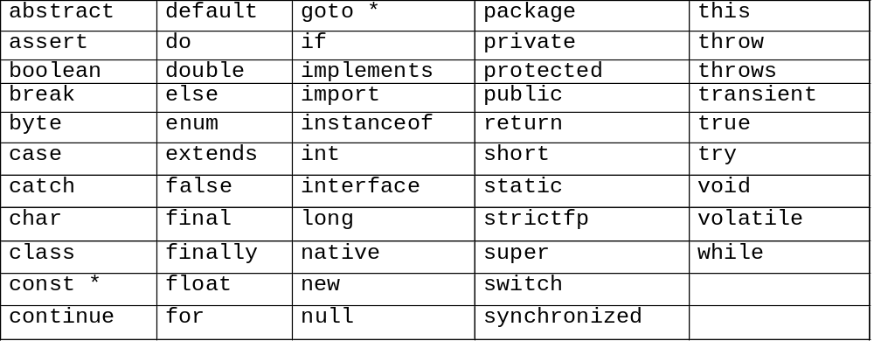
Java Reserved Words
These are Java’s keywords, which signal the compiler to perform some internal operation. You cannot use these words as identifiers!
Notes:
Java has only 53 keywords compared with 63 in C++.
Some of these words are reserved but not used (goto, const).

Slide 8
Putting Comments in Source Code
Two slashes together indicate that the rest of the line is a comment (unless the slashes are inside single or double quotes).
Multiple line comments are started with /* and end with a */.
If a multiple line comment starts with /** instead of /*, the contents of the comment will be included in the documentation generated by javadoc – Java’s documentation program.
Notes:
Single line comments run from the double slash (//) to the end of the line:
Account tempAcc = new Account() // temporary used for storage
Javadoc comments are processed by the javadoc tool and create HTML documentation for your classes. The system documentation takes this form:
/**
* This class describes the features of a bank account.
* @author S.W.
* @version
*/
public abstract class Account {...
The items preceded by the @ symbol are special javadoc tags.

Slide 9
An Example of Comment Usage
public class Car {
// instance attributes
private int speed; // current speed
/** Constructor that sets speed
* We do not want a Car whose speed is unknown.
*/
public Car( int s ) {
speed = s;
}
}

Slide 10
Non Object Data in Java
Java uses several types of constructs:
  Outermost Blocks
    Classes
    Interfaces
    Annotations
    Enums
  Other types
    Arrays
    Primitives
In the next several slides we will discuss Primitives and Arrays. The other types will be discussed later.

Slide 11
Primitive Data Types
Primitives are simply variables to hold data.
Java provides several primitive data types. They are:
short, int, long, float, double,
boolean, char, byte
Details of these eight types are covered in the following slides.

Slide 12
Integer Types
The integer types in Java are byte, short, int and long.
Arithmetic expressions can throw exceptions (errors) for circumstances such as divide by zero.
  The notion of throwing an exception will be covered later.
The compiler assumes literals are integer values; to declare a long literal use - long myLong = 23456L;
Notes:
The compiler assumes that a literal integer is always of type int so when you want to assign a literal to a long variable you must do so explicitly by adding a capital L to the end of your literal. For example:
long myLong = 23456L;
Ordinarily we expect integer variables to be expressed in our natural decimal notation so that forty-five is expressed as 45. However in Java, integers can be expressed in octal, decimal or hexadecimal.
To express a literal in Octal, add a leading zero (e.g. 055).
To express a literal in Hexadecimal, add a leading 0x (e.g. 0x2D).
The three variables below all contain the same integer value:
int a = 45;
int b = 055; // Literals with a leading zero are taken as octal values.
int c = 0x2D; // Literals with a leading 0 and a lower-case x are taken as hexadecimal values.

Slide 13
Real Number Types
Real numbers are represented by float and double types.
Real numbers also include special values for Infinity and NaN.
Real number literals default to double
To declare a float, suffix with F
  float myFloat = 234.78F;
Notes:
float myFloat = 234.78; // will not compile
float myFloat = 234.78F; // ok

Slide 14
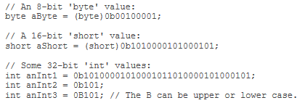
Assigning Binary Literals
Binary Literals
    In Java SE 7, the integral types (byte, short, int, and long) can also be expressed using the binary number system.
    To specify a binary literal, add the prefix 0b or 0B to the number.

Slide 15
Numeric Literals
Underscores in Numeric Literals
    any number of underscore characters (_) can appear anywhere between digits in a numerical literal.
    separate groups of digits in numeric literals, which can improve the readability of your code.
Notes:
You can place underscores only between digits; you cannot place underscores in the following places:
At the beginning or end of a number
Adjacent to a decimal point in a floating point literal
Prior to an F or L suffix
In positions where a string of digits is expected

Slide 16
The Char Type
Characters in Java are 16 bit Unicode characters.
Unicode captures many alphabets including ideographic languages such as Mandarin.
Character literals can be expressed as 'a'.
There are escape sequences for non-printing characters such as \n for newline and even \b for bell.
Notes:
Escape Sequence Unicode Value Character
\b \u0008 Backspace
\t \u0009 Tab
\n \u000a Linefeed
\f \u000c Form feed
\r \u000d Carriage return
\” \u0022 Double quote
\’ \u0027 Apostrophe
\\ \u005c Backslash

Slide 17
The Char Type
Internationalization Support Update
  The final version of the Java SE 7 release supports Unicode 6.0.0.
  This is a major version of the Unicode Standard and adds support for over 2000 additional characters, as well as support for properties and data files.
Notes:
java.lang.Package
Multithreaded Custom Class Loaders in Java SE 7
The Java SE 7 release contains an important enhancement for multithreaded custom class loaders.
In previous releases, certain types of custom class loaders were prone to deadlock. The Java SE 7 release modifies the locking mechanism to avoid deadlock.
Java Virtual Machine
Garbage-First Collector
Improved optimization
Java HotSpot Virtual machine performance Enhancements

Slide 18
The Boolean Type
A Boolean value is either:
  true
  false
Other languages often address Booleans using numeric values, typically 0 is false 1 (or anything positive) is true. Not valid in Java
  if (true){
    System.out.println ("Always prints!");
  }
Notes:
We will discuss control statements such as "if" later in the course.

Slide 19
Creating Primitives
To create a primitive, simply state its type and name separated by a space and followed by a semi-colon.
  int x;
  boolean isStarted;
If you have several primitives of the same type you can create them in a comma separated list:
int x, y, z;
boolean isStarted, isAcceptable;
Notes:
Creating variables of the same type in a comma separated list is frowned upon by most Java developers.

Slide 20
Creating Primitives
You can declare primitives anywhere in your code.
Their placement affects their visibility.
Primitives that are declared inside a code block are only visible inside that block.
Primitives are also only visible below the point at which they are declared.

Slide 21
Naming Conventions for Primitives
Primitives and methods share the same naming convention: the first word in the name is lowercase, the first letter in each additional word in the name is uppercase ( Low Camel Case)
For finals, words are separated by underscores
(Snake case) and are all capitals
public class Car {
// Some “primitive” data
private int numberOfDoors;
private int numberOfWheels;
}

Slide 22
Initializing Primitives
If you do not assign a value to a primitive, Java automatically uses a default value.
Otherwise, you can assign an initial value at the time you declare the variable
  Note that best practice dictates that these types of variables are given values in constructor methods which we will cover later.
public class Car {
// Some “primitive” data
private int numberOfDoors = 2;
private int numberOfWheels = 4;
}

Slide 23
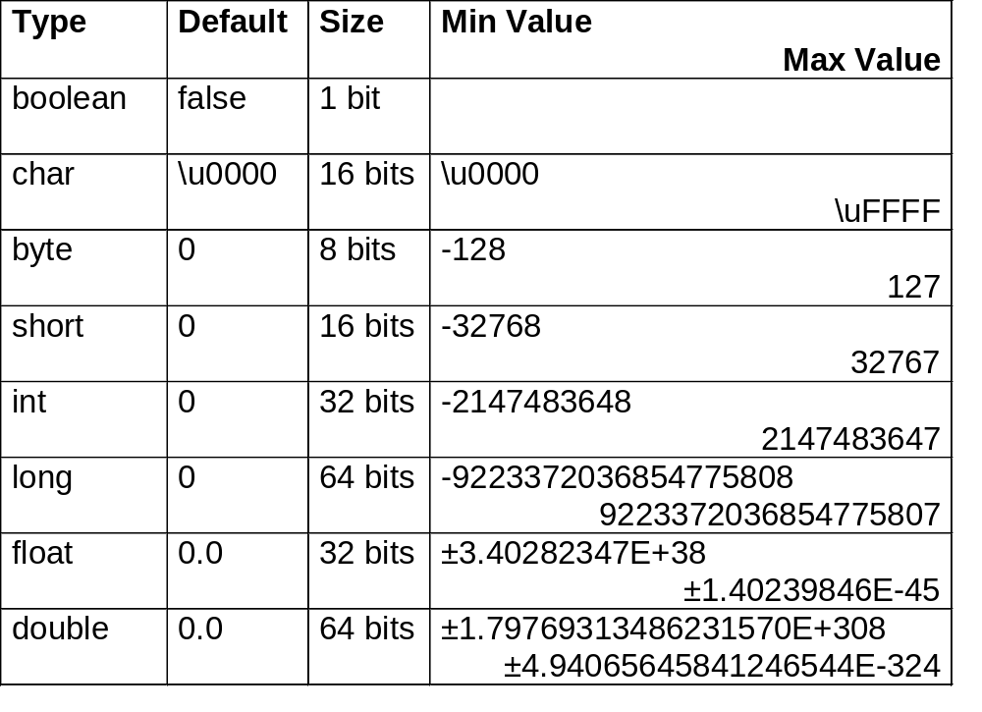
The Range of Primitive Types
Notes:
Java adds byte and Boolean types to the set of primitive types available in C.
Java standardizes the amount of memory allocated to each type. This allows for ease of portability of programs.
Java’s integer types are all signed.
This consistency is a big help in achieving platform independence.

Slide 24
The Eight Wrapper Classes
For each of the eight primitive types there is a corresponding Java class.
Java’s structure makes it impossible to use primitives in certain situations. In these cases, the wrapper classes must be used instead.
Primitive | Wrapper Class |  | Primitive | Wrapper Class
int | Integer |  | short | Short
long | Long |  | float | Float
boolean | Boolean |  | double | Double
char | Character |  | byte | Byte
Notes:
We will see the Wrapper classes in more detail when we discuss containers later in the course.

Slide 25
Boxing and Unboxing
Primitive values may be assigned to the corresponding Java wrapper class.
  Assigning a primitive value to an “instance” of the wrapper class is called boxing.
  int i = 3;
  Integer w1 = i; // value of w1 is 3
  Integer w2 = 5; // value of w2 is 5
  Assigning the wrapper instance to a primitive is called unboxing.
int j = w2; // value of j is 5
Notes:
The autoboxing features of Java were not available until version 5. Note that the use of the new keyword for instantiation (to be discussed later) is not required for the wrapper objects.

Slide 26
Java Arrays
Arrays allow you to define a grouping of primitives or objects with the same name.
Each entry in the grouping is referenced by a number known as the index ranging from zero to one less than the size of the array.
Arrays in Java are objects.
To create an array reference, you state the type followed by square brackets and a name:
int[] myIntArray;
This simply tells the compiler that we want an array of ints. It doesn’t say how many, or what their values will be.

Slide 27
Initializing Arrays
To initialize an array we use the new operator and another set of square brackets like this:
int[] myIntArray = new int[25];
This statement tells the compiler to set up space for 25 ints.
Now we can set the value of the first int in the array:
myIntArray[0] = 42;
Notes:
Notice that the FIRST entry in the array is indexed by zero.

Slide 28
Initialization Short Cut
Java will accept the following syntax to create an array and set its length and values all in one statement:
int[] myIntArray = { 11,12,13,14,15 };
This statement creates an array called myIntArray which has a length of five. The first entry (myIntArray[0]) is set to 11 and the last entry (myIntArray[4]) is set to 15
Notes:
Java provides the shorthand notation above which does not require the new operator but will work the same as if you had written the following:
int[] myIntArray = new int[5];
myIntArray[0] = 11;
myIntArray[1] = 12;
myIntArray[2] = 13;
myIntArray[3] = 14;
myIntArray[4] = 15;

Slide 29
Arrays and Objects
You can create arrays on any of the eight primitive types.
You can also create them from any Java object reference. For example, here is an array of Strings:
String[] pets = {"Fido", "Rex", "Princess" };
The String class will be covered in detail later.

Slide 30
Arrays: Notes
Java provides every Array you create with a single attribute named length.
This is useful since the length of an array is a piece of information you’ll need almost every time you work with an array.
To put the length (number of elements) of myIntArray into an int called x we would code:
  int x = myIntArray.length;

